Slide 1
Mobile Database browser project
Kevin Osborn
Vice President of Technology
Namemedia

Slide 2
About Namemedia
Headquartered in Waltham, MA
Two businesses
Domain Name marketplace – selling aftermarket domain names for ourselves and affiliate customers
Media Network
Enthusiast community websites
Craftster.org, davesgarden.com, tarot.com, photo.net, etc.
Domain (portfolio) monetization
PPC advertising
Ecommerce
PPV advertising on aggregated content

Slide 3
Connecting Media network users
Web based “encyclopedias” of useful information
Current Cases
Plantfiles – descriptions/hardiness information
Bugfiles – bug identification
Birdfiles – bird identification
Members can comment and upload photos

Slide 4
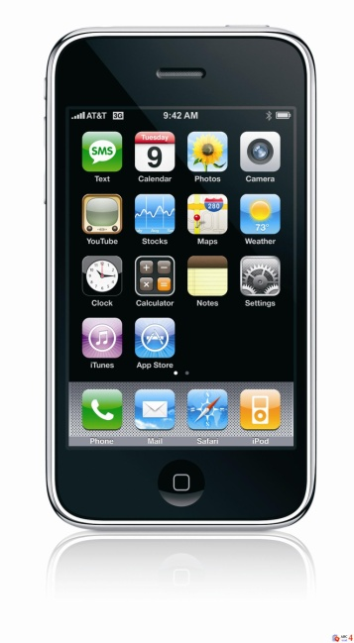
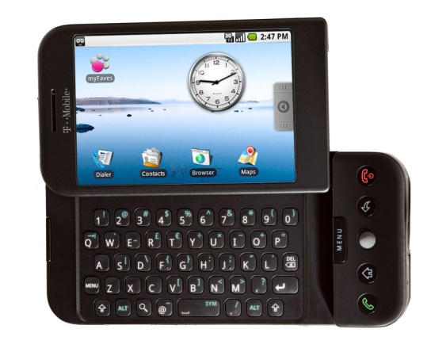
Connected case
UI templates
Server
Iphone display engine
Web service API
Proxy API
Search
Android display engine
Navigation.xml

Slide 5
Totally mobile case
UI templates
Iphone display engine
Embedded database
Search
Android display engine
Navigation.xml

Slide 6
Some requirements/challenges
Location awareness (e.g. zone hardiness for plant database)
Optional authentication for connected instances
Migrating data and compressing for mobile use in portable case
Actual databases can’t be released open source
Find alternative examples for OS release

Slide 7
Generic Forum/social media app
Similar to Facebook App on iPhone but for forums
Skinnable
“Favorite” topics/forums
Post text and photos
Proxy API layer to talk to forums software
Eventually support multiple forums
Vbulletin, Simple Machines forum priorities
Profile editing and authentication

